Slide 1
Christian Societies in Medieval Europe
Christian Society
Medieval Society and Political Developments
The Crusades

Slide 2
Christian Society
Rise of the church
  Germanic Tribes
    Woden, Tiu, Thor, and Friia
    Saturnalia and Winter Solstice
Frankish Empire
  Carolingians
    Charlemagne (r. 768-814 C.E.)
Social and Political Power of the Church
  Thomas Aquinas and Summa Theologia

Slide 3
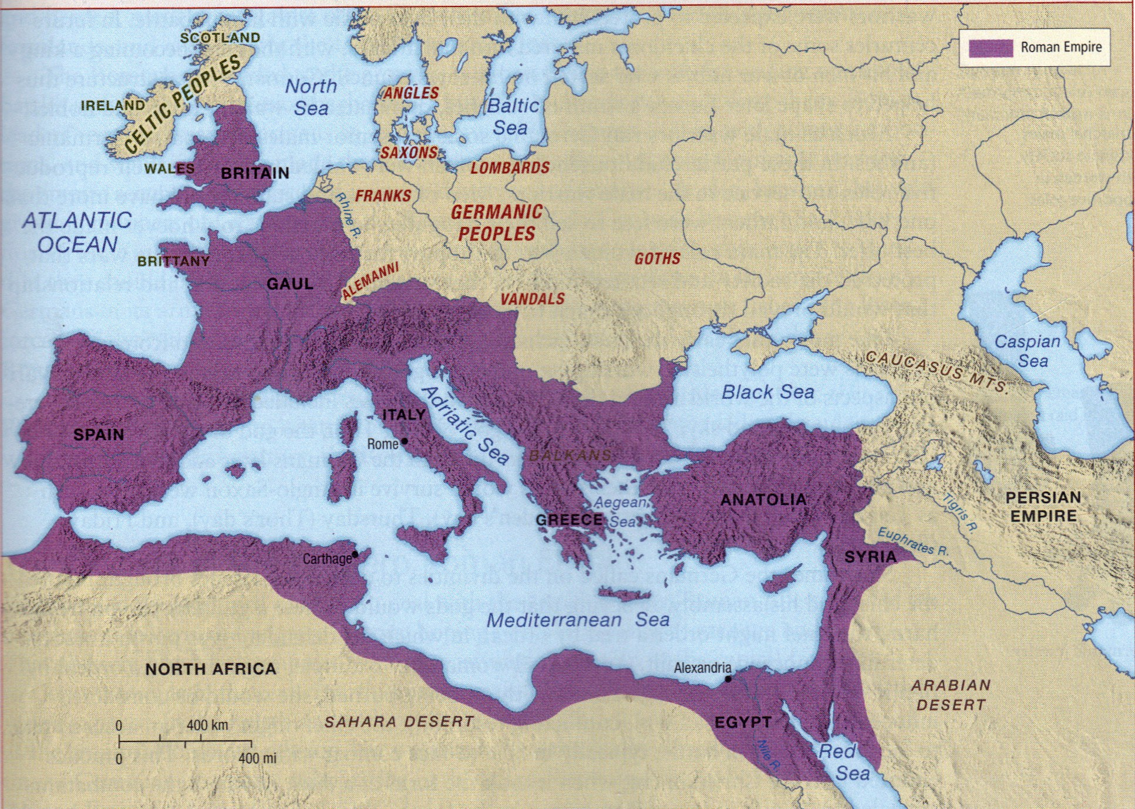

Slide 4
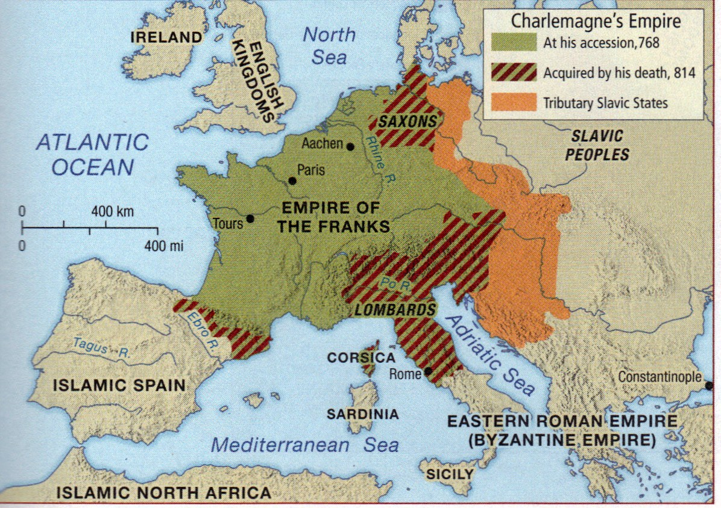

Slide 5
Medieval Society and
Political Developments
Medieval Cities and Towns
  Bourgeoisie
New European States
  France
    King Philip IV (r. 1285-1314) and the Estates-General
  England
    King John (r. 1199-1216) and the Magna Carta
    King Edward I (r. 1272-1307) and the Model Parliament

Slide 6
The Crusades
First Crusade (1095-1099)
Second Crusade (1147-1149)
Third Crusade (1189-1192)
  Saladin
Fourth Crusade (1202-1204)

Slide 7
